Slide 1

CROSS SELLING RECOMMENDATIONS FOR XYZ CREDIT UNION
MAY 26th, 2023.

Slide 2

Presented by: HEGY GROUP
B. Harika Reddy
Yusuf Yuhan
Ebaghae Imhanlahimi
Gladys Kalas

Slide 3
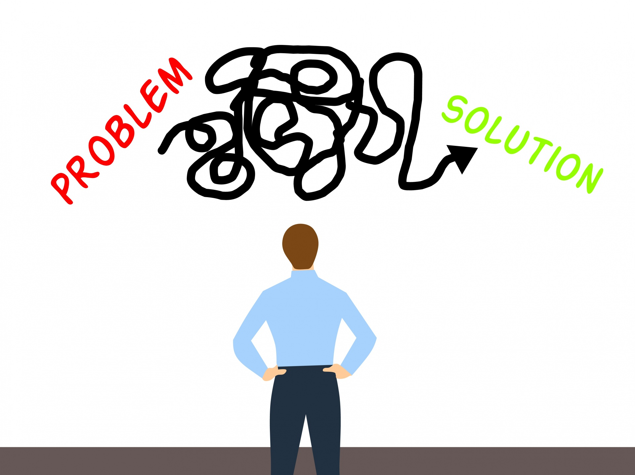
Problem STATEMENT
XYZ credit union in Latin America is performing very well in selling their Banking products. However, majority of their existing customers do not buy more than 1 product which means that the bank is not performing well in cross selling. XYZ wants solutions that will help to increase multiple sales of their products to their existing customers.

Slide 4

solutions
Based on insights obtained from the analysis carried out, it is recommended that XYZ credit union cross sell their products to existing customers.
To help increase cross selling of banking products among existing customers, the following recommendations have been given based on insights obtained from analysis of the data.
This Photo by Unknown author is licensed under CC BY-SA.

Slide 5

Reward customer loyalty
Description: From the analysis of the data provided, we saw that customers who have been with the bank for at least 10 years are few, but majority of these customers purchase more than 1 product. Promotional product packages can be offered to these customers to increase purchase of multiple products.
Benefits:
It will build customer loyalty and increase cross selling opportunities.
Next Step: It is recommended that promotional products should be offered to customers who have been in the bank for at least 10 years as a way of rewarding their loyalty, this may encourage purchase of more than one product by these customers.
This Photo by Unknown author is licensed under CC BY-SA.

Slide 6

2. build customers trust and confidence
Description: The data showed that a good majority of existing customers have been in the bank for about 2 years and less than 10 years, they make up most of the customer population. A good number of these customers purchase only one product. The bank needs to implement policies to build customers trust and confidence in its services.
Benefits:
This may help to build customers confidence in the bank's services and encourage purchase of multiple products by existing customers.
Next step: It is recommended that customer loyalty be built by implementing policies that will build customer trust in the bank and its products. Surveys should be carried out in this target population to find out why they purchase only one product.
This Photo by Unknown author is licensed under CC BY.

Slide 7

3. Encourage customers to be active
Description: Majority of customers are inactive and purchase only 1 product. Analysis results revealed that customers who had an active relation with the bank were more likely to buy multiple products when compared to other customer relation categories.
Benefits:
Increasing existing customers interest in multiple products. And Increase cross selling of products.
Next Steps:
Research should be carried out and strategies based on results from the research should be implemented to encourage inactive customers to be active.
Also, XYZ credit union should target active customers when cross selling products, as analysis has shown that they are more likely to purchase multiple products.

Slide 8

4. create product bundle offers
Description: Analysis revealed that among all the products offered, Payroll Account and Direct Debit are commonly purchased together by customers, it would be beneficial for the bank to create bundle offers for these two products.
Benefits:
This may help to encourage purchase of multiple products by customers.
Next Step: Create attractive bundle packages with these products and offer to customers.
This Photo by Unknown author is licensed under CC BY-ND.

Slide 9

5. Preach about the benefits of Bundles
Description: Results of the analysis showed that Saving Account is commonly purchased alone, which could indicate that customers are not aware of the benefits of buying multiple products or bundling products.
Benefits:
Create awareness in customers of benefits in purchasing multiple products.
Increase cross selling.
Next steps: The bank should consider creating awareness campaigns targeted towards customers with only savings account, to create awareness of the benefits of bundling or purchasing multiple products.

Slide 10

6. identify causes of decline in product purchase
Description: Analysis showed that there has been a decline in the purchase of several products year on year, this decline needs to be investigated.
Benefits:
Potential increase in product purchase and resolving issues causing the decline.
Next Steps: XYZ credit union should investigate this using customer feedback surveys and other methods, and review the causes of the decline. This will enable them to identify the issues and take corrective actions to prevent future occurrence.
This Photo by Unknown author is licensed under CC BY.

Slide 11

7. FOCUS ON POPULAR PRODUCTS
Description: Maximizing the potential of our four most popular products: Current Accounts, Private Account, Direct Debit, and E-Account. Leveraging their popularity to strengthen customer loyalty, increase cross-selling opportunities, and gain a competitive advantage.
Benefits :
Strengthened Customer Loyalty
Increased Cross-Selling Opportunities
Competitive Advantage
Next Steps: In-Depth Market Research, Collaborate with Product Development Teams, Develop Targeted Marketing Campaigns, Monitor and Measure Results, Continuous Improvement
This Photo by Unknown author is licensed under CC BY-NC-ND.

Slide 12

8. TARGETING OLDER AGE GROUP
Description: Targeting the older age group to capitalize on their preference for Pensions and Mortgage products. Expanding our offerings and tailoring marketing strategies to cater to their specific needs, ensuring a successful cross-selling approach.
Benefits:
Increased Revenue from Pensions and Mortgage Products and enhanced Customer Satisfaction and Retention.
Next Steps: Conduct Market Research on Older Age Segment, Refine Product Offerings, Develop Personalized Marketing Campaigns, Collaborate with Sales and Customer Service Teams, Monitor and Evaluate Performance.

Slide 13
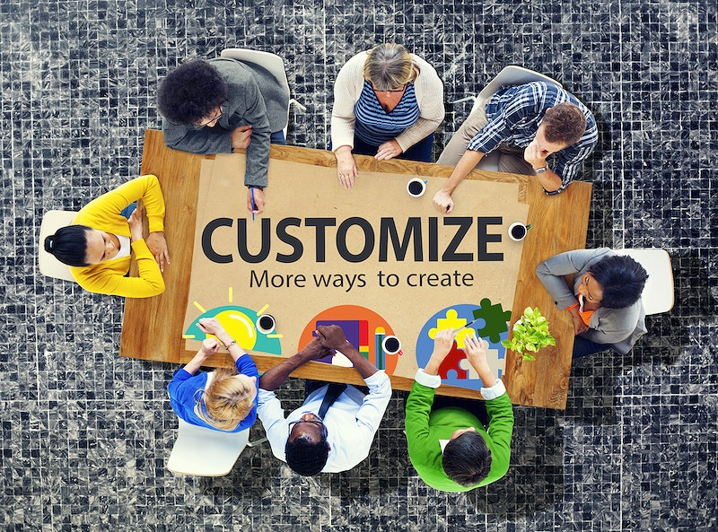
9. PERSONALIZED PRODUCTS FOR YOUNGER AGE GROUP
Description: Creating personalized products to cater to the needs of the younger age group, with a focus on Current Accounts and Payroll Accounts. By understanding their unique preferences and providing tailored solutions, we can capture their attention and drive cross-selling opportunities.
Benefits:
Increased Engagement and Adoption of Current Accounts and Payroll Accounts
Enhanced Customer Loyalty and Lifetime Value
Next Steps: Conduct Customer Surveys and Focus Groups, Develop Innovative Product Features, Implement Targeted Marketing Campaigns, Collaborate with Marketing and Product Development Teams, Monitor and Measure Product Performance.

Slide 14

10. STRATEGIZE TO ATTRACT MORE CUSTOMERS
Description: Implementing strategies to attract more customers and reverse the decline in customer acquisitions. By identifying the root causes of the decline and proposing effective approaches, we can reignite customer interest and expand our customer base.
Benefits:
Increased Customer Acquisition and Market Penetration.
Improved Business Growth and Revenue Generation
Next Steps: Conduct Market Research and Competitive Analysis, Develop Targeted Marketing and Advertising Campaigns, Enhance Customer Engagement Programs, Collaborate with Sales and Marketing Teams, Monitor and Evaluate Customer Acquisition Metrics.

Slide 15

11. TARGET FEMALE CUSTOMERS FOR CROSS SELLING
Description: Targeting female customers for cross-selling to capitalize on their tendency to purchase multiple products. Leveraging this trend can significantly increase product uptake and revenue generation.
Benefits:
Increased Cross-Selling Revenue and Product Adoption
Enhanced Customer Loyalty and Retention
Next Steps: Develop Targeted Marketing Campaigns for Female Customers, Tailor Product Bundles to Match Their Preferences, Provide Personalized Recommendations Based on Purchase History, Offer Exclusive Promotions and Rewards, Monitor and Analyze Cross-Selling Metrics.
This Photo by Unknown author is licensed under CC BY-SA.

Slide 16
12. EXPANSION AND TARGETED MARKETING
Description: Expand banking facilities and branches, particularly in provinces with lower customer presence, to increase accessibility and market penetration. Implement targeted marketing programs to effectively reach diverse customer segments.
Benefits:
Increased Market Reach and Customer Acquisition
Improved Brand Visibility and Customer Engagement
Next Steps: Conduct Market Research to Identify Provinces with Potential, Establish New Banking Facilities and Branches in Strategic Locations, Tailor Marketing Strategies to Local Demographics and Customer Preferences, Collaborate with Local Businesses and Partnerships for Promotional Campaigns, Monitor and Evaluate Performance of Expansion Efforts.
This Photo by Unknown author is licensed under CC BY-SA.

Slide 17

SUMMARY AND CONCLUSION
Driving Cross-Selling Success: Key Takeaways
Throughout this presentation, we have explored key recommendations and strategies to enhance cross-selling for XYZ Credit Union.
By focusing on the four most popular products and further improving them, XYZ Credit Union can attract more customers and increase product adoption.
Targeting specific customer segments, such as the older age group and younger age group, allows the bank to tailor its offerings and meet the unique needs of each segment.
Recognizing and rewarding customer loyalty is crucial in encouraging multiple product purchases. Offering promotional products to long-standing customers can strengthen their commitment to the bank.
Building trust and confidence among customers is essential for fostering a positive relationship. By implementing policies that prioritize customer satisfaction and security, XYZ Credit Union can instill trust and increase cross-selling opportunities.
This Photo by Unknown author is licensed under CC BY-SA.

Slide 18
SUMMARY AND CONCLUSION
Driving Cross-Selling Success: Key Takeaways
Encouraging inactive customers to become active and engaging with active customers can lead to higher product adoption rates. XYZ Credit Union should focus on personalized communication and targeted offers to drive customer engagement.
Product bundling, particularly with Payroll Account and Direct Debit, presents an opportunity to incentivize customers to purchase multiple products simultaneously.
Raising awareness about the benefits of bundling and the value of purchasing multiple products can help expand customers' understanding and drive cross-selling success.
Identifying the causes of the decline in product purchases year-on-year is crucial. By addressing the underlying issues, XYZ Credit Union can implement corrective actions to prevent future declines and foster sustainable growth.
Overall, by implementing these recommendations and strategies, XYZ Credit Union can enhance its cross-selling efforts, increase customer satisfaction, and drive long-term profitability.
This Photo by Unknown author is licensed under CC BY-SA.

Slide 19

Thank you for your time and attention.
With a customer-centric approach and a focus on continuous improvement, XYZ Credit Union is well-positioned to achieve significant success in its cross-selling initiatives.
This Photo by Unknown author is licensed under CC BY-SA-NC.

